Slide 1
The “Food Basket Experiment”
Within Wp1
Xhakollari ,Srinivasan, Balcombe, Law (Reading) Fraser (Kent)

Slide 2
Methods/Approaches
Not a discrete Choice Experiment – really a “Shopping Experiment
Approx 1500 people asked to do a “online shop” of some “typical” items (102 Items) within the “Family Foods” data set where the prices are varied as in Caputo and Lusk Food Policy (2022) .
Choices used to compute the demand price elasticities of each item
Consequent changes for nutrient consumption across the population on average (and possibly different groups) calculated
People were also given nutrient information relative to suggested guidelines and the chance to rethink their choices based on that information

Slide 3
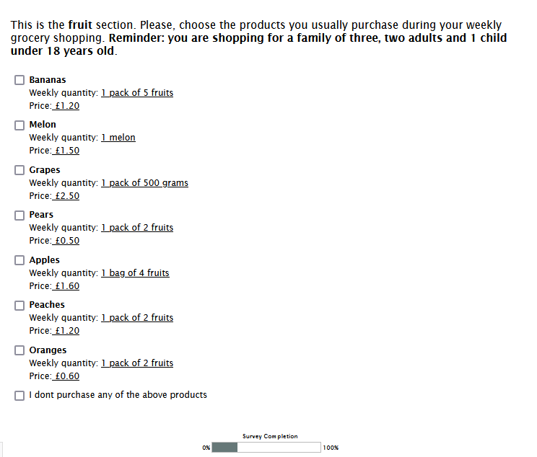
The choices were divided up in to “Shelves” and people were faced with choices like the following
Shelves
Beverages
Bread
Cereals
Confectionary
Dairy
Fats
Fruit
Other

Slide 4
Price Variation
For our prices we for each option we took a
A typical price (based on Family Foods data)
Had to two higher prices and two lower prices
The higher prices were up to 50% higher than the mid price and the lower price was 50% of the mid price.

Slide 5
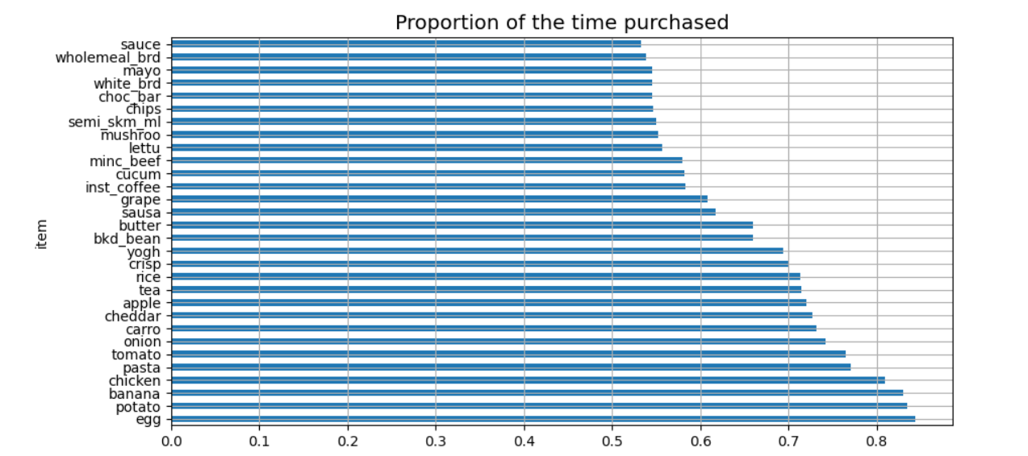
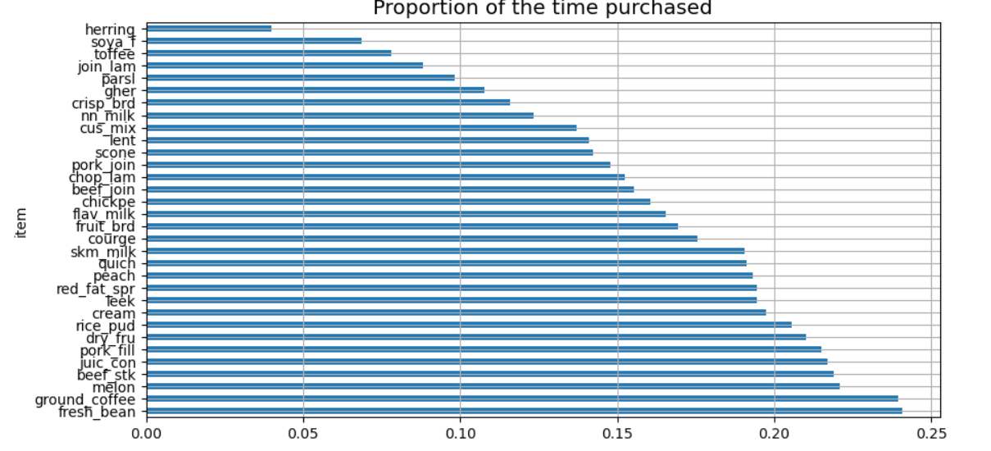
The 30 items purchased most frequently were
The 30 items purchased least frequently were

Slide 6
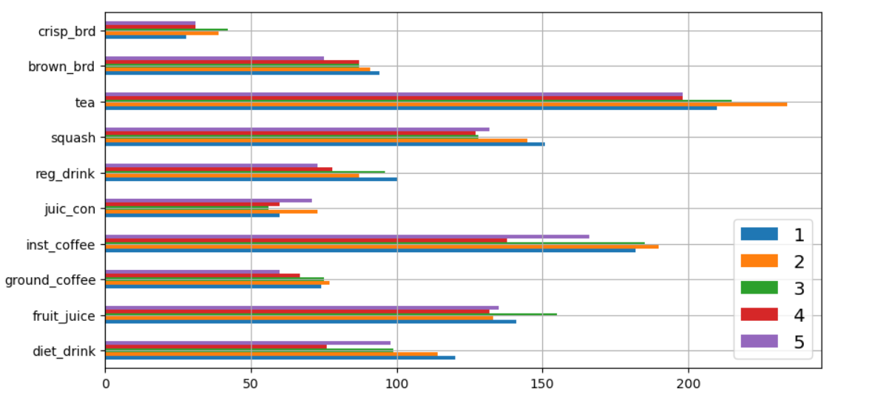
People were not price sensitive!
e.g. – 5 represents the higher price amd the bars represent frequency of purchase

Slide 7
Hardly anybody rethought their choices after seeing the nutrient information

Slide 8
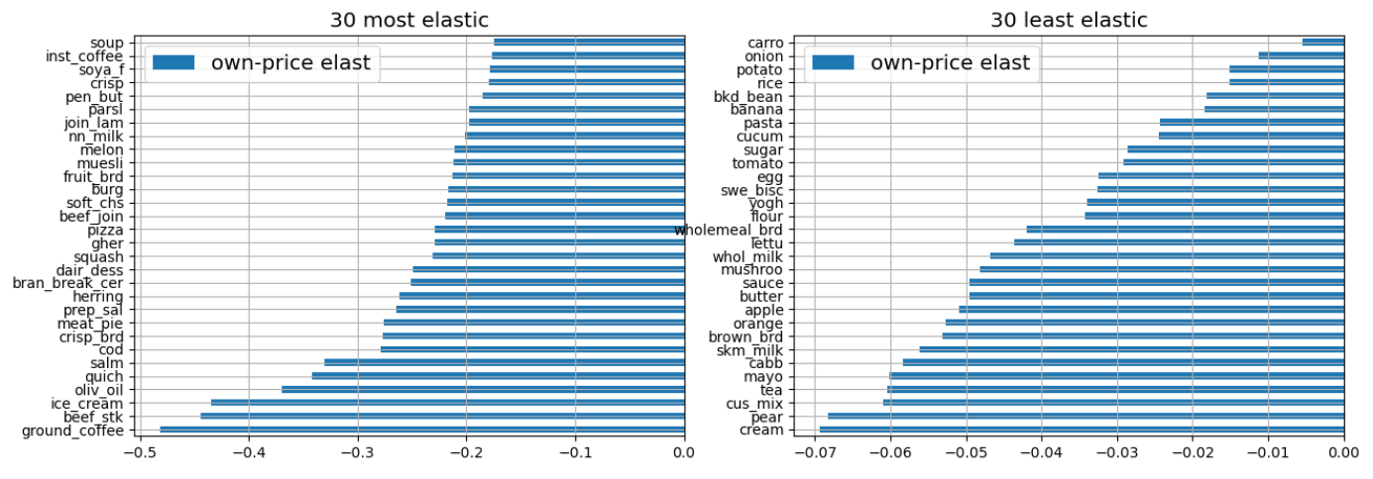
The price elasticities were correspondingly small
e.g.
beverages
Notes:
8

Slide 9
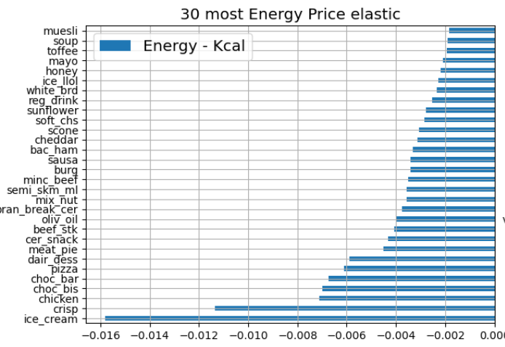
The Nutrient Price Elasticities are Correspondingly Small
For example, take Energy

Slide 10
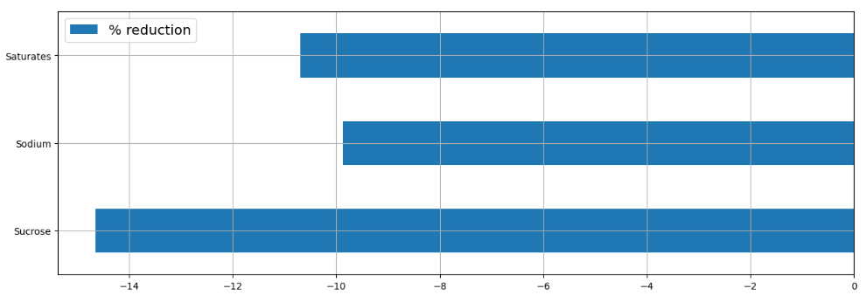
The impact of a doubling of the price (e.g. a 100% tax) of items
with the top 25% content of Saturates, Sodium and Sucrose

Slide 11
Reflections on the Basket Experiment
Results may reflect hypothetical bias and lack of consequentialism.
Long task people may become bored or tired
May lack the necessary cues about size and price available in a real shopping environment
BUT
May reflect real price insensitivity in “one-off” shopping experiences for items that are commonly purchased
Real price elasticities may be “long-run” phenomena where purchase behaviour is shaped over repeated purchases and the “feedback” that might entail.

